Slide 1
Analysis of Common Methods of Stereo Matching
SM
Xinliang Zhong

Slide 2
Outline
· Introduction to stereo vision
· Overview of a stereo vision system
· Algorithms for stereo matching
· Applications

Slide 3
What is stereo vision？
Is a technique aimed at inferring depth from two or more cameras
Wide research topic in computer vision
This seminar is concerned with
binocular stereo vision systems
dense stereo algorithms
stereo vision applications

Slide 4
Applications

Slide 5
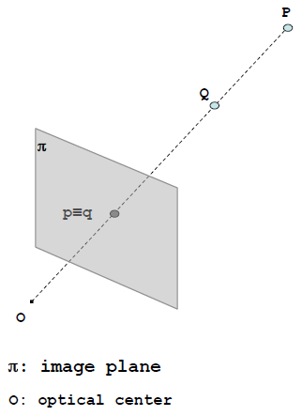


Single camera
Both (real) points (P and Q) project into the
same image point (p ≡ q)
This occurs for each point along the same line
of sight
Useful for optical illusions…

Slide 6
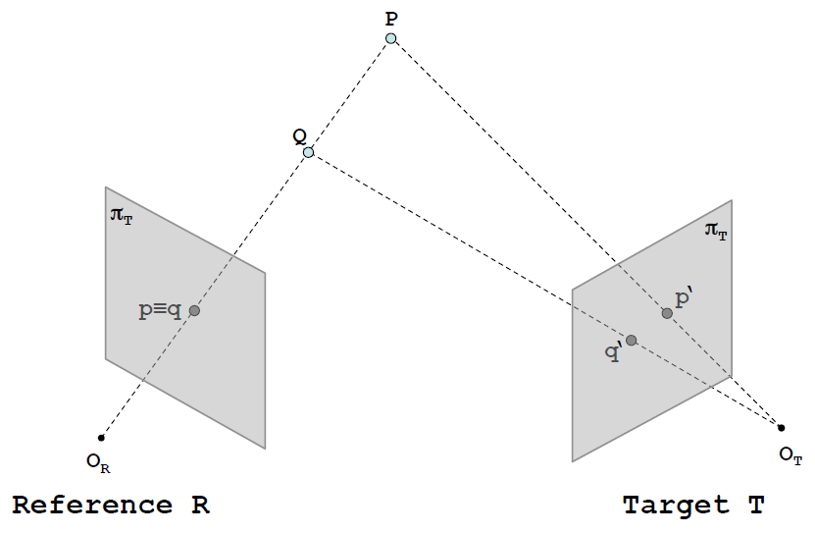
Stereo camera
With two (or more) cameras we can infer depth, by means of triangulation, if we are able to find corresponding (homologous) points in the two images.

Slide 7
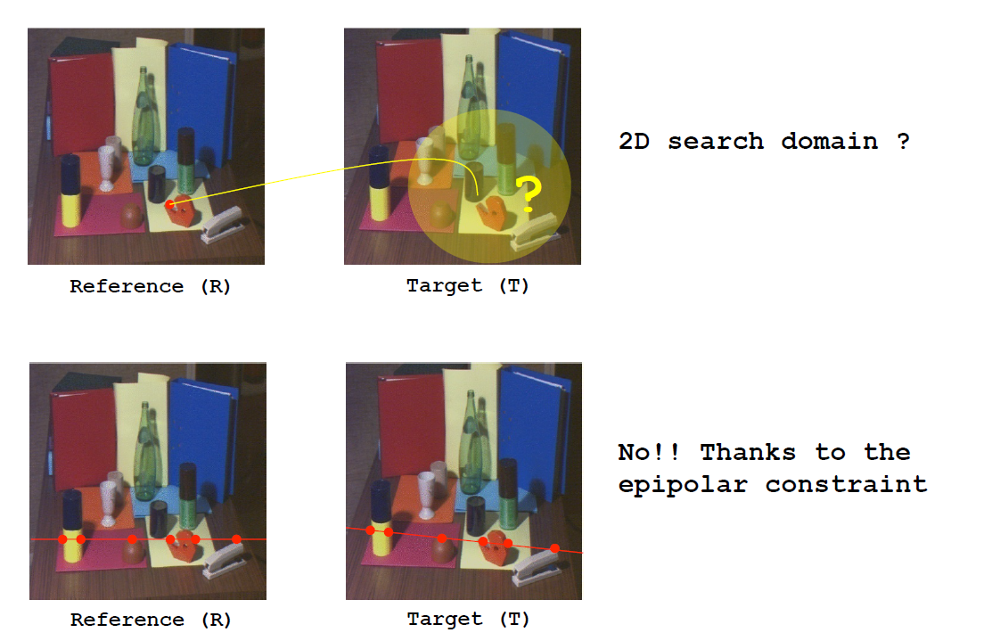
How to solve the correspondence problem

Slide 8
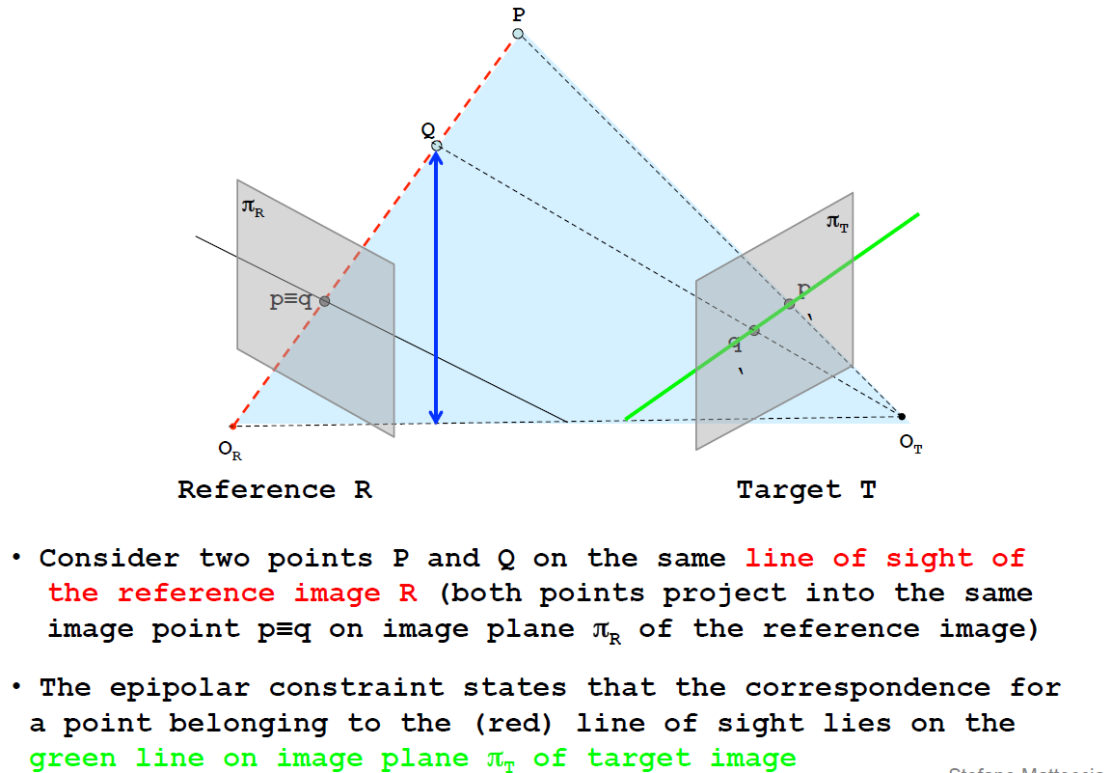
Epipolar constraint

Slide 9
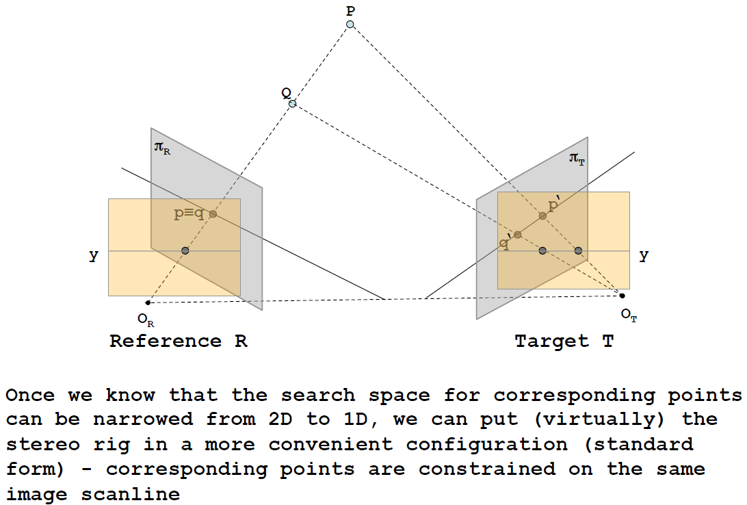
Epipolar constraint

Slide 10
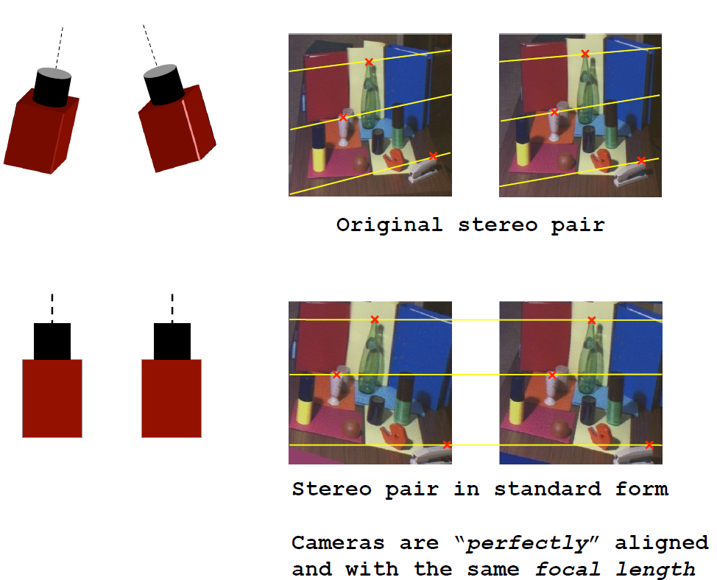

Slide 11
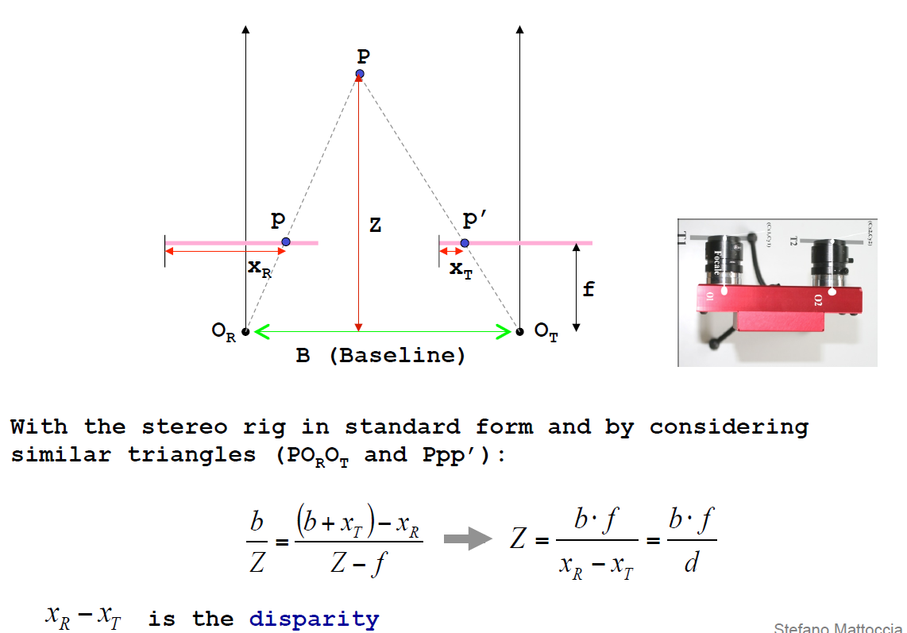
Disparity and depth

Slide 12
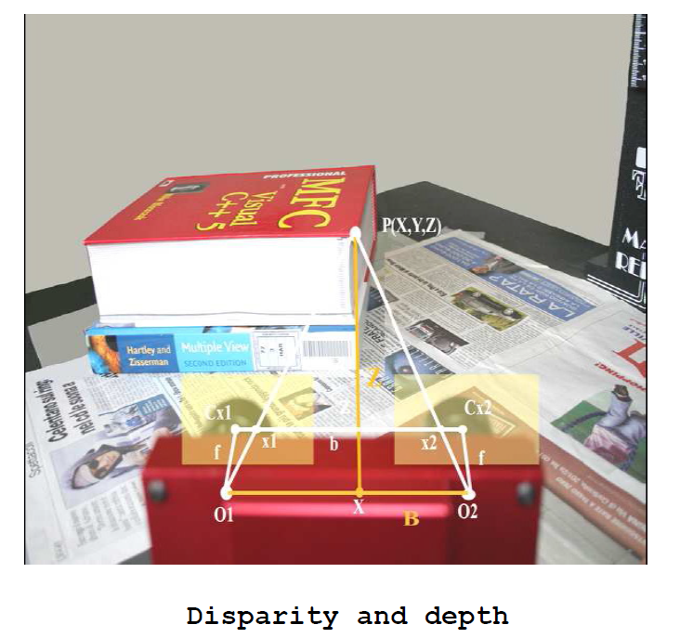

Slide 13
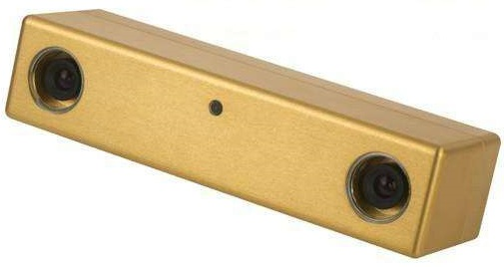
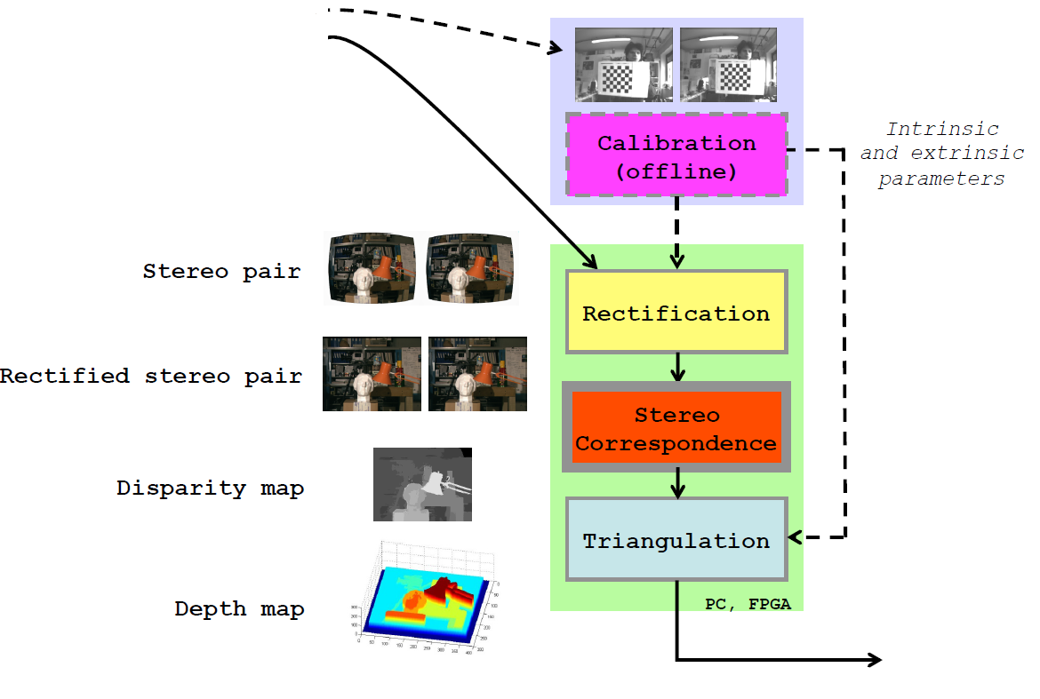
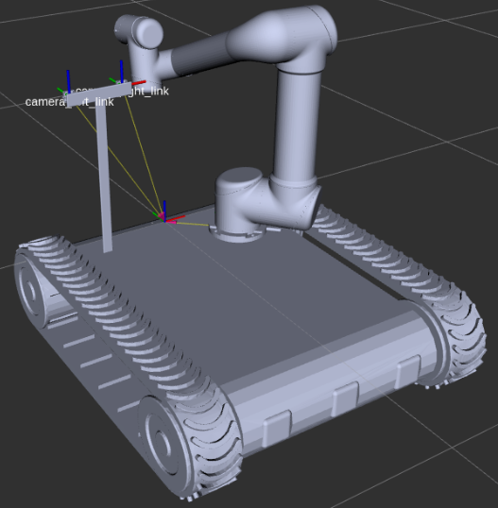
Overview of a stereo vision system
？？？

Slide 15
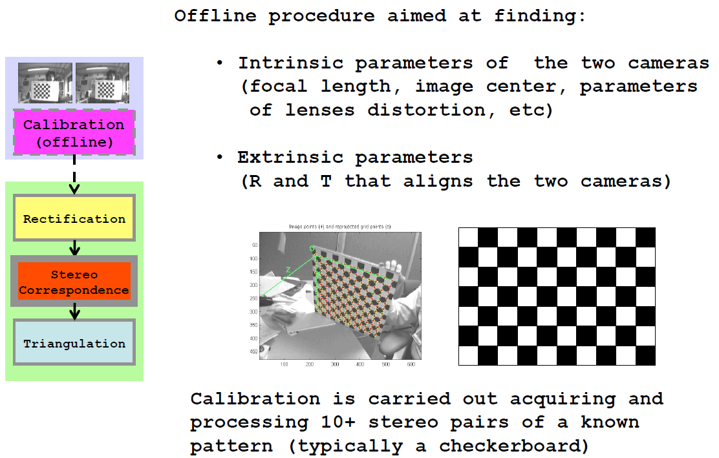
Calibration（offline）

Slide 16
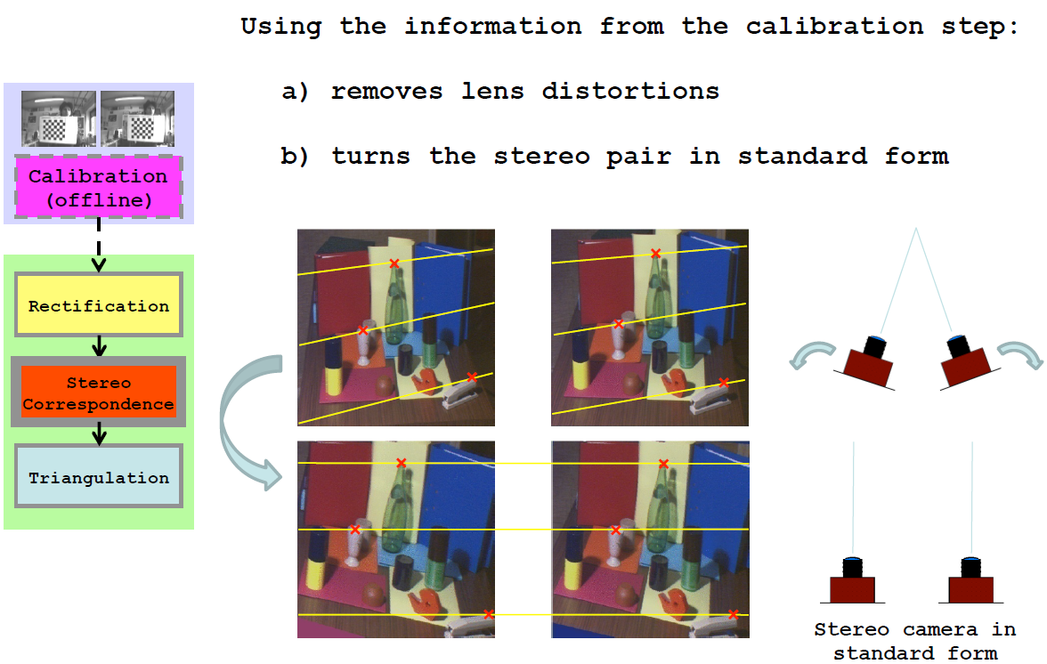
Rectification

Slide 17
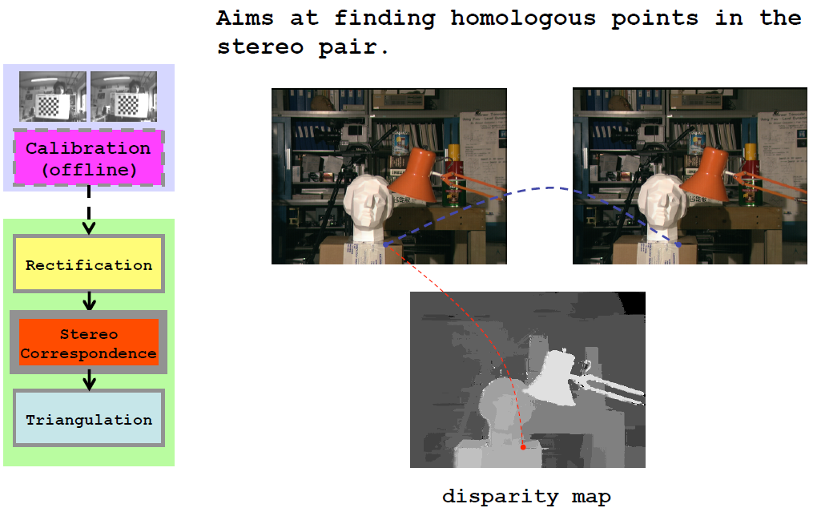
Stereo Correspondence

Slide 18
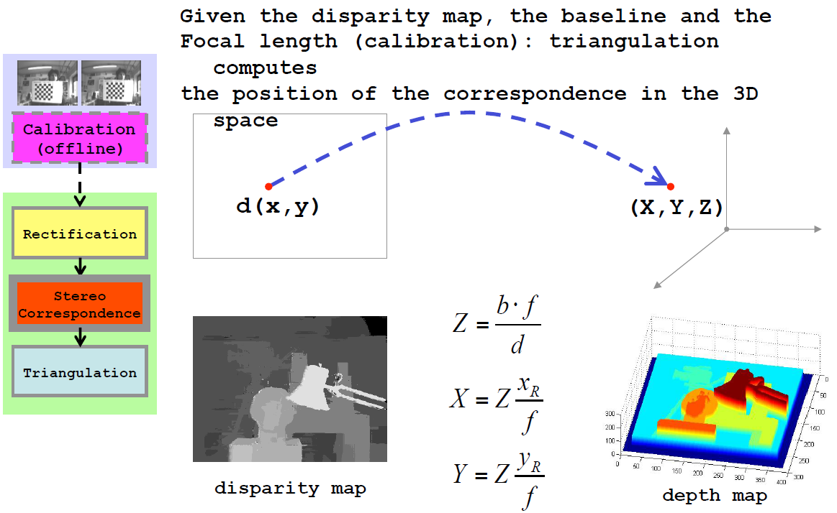
Triangulation

Slide 19
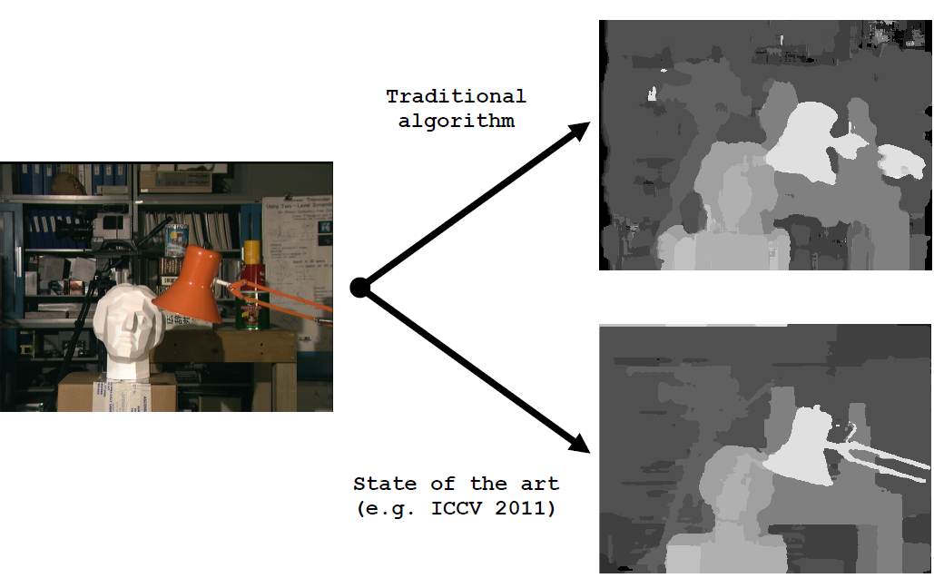
Key module in stereo vision?
The algorithm is crucial in this technology

Slide 20
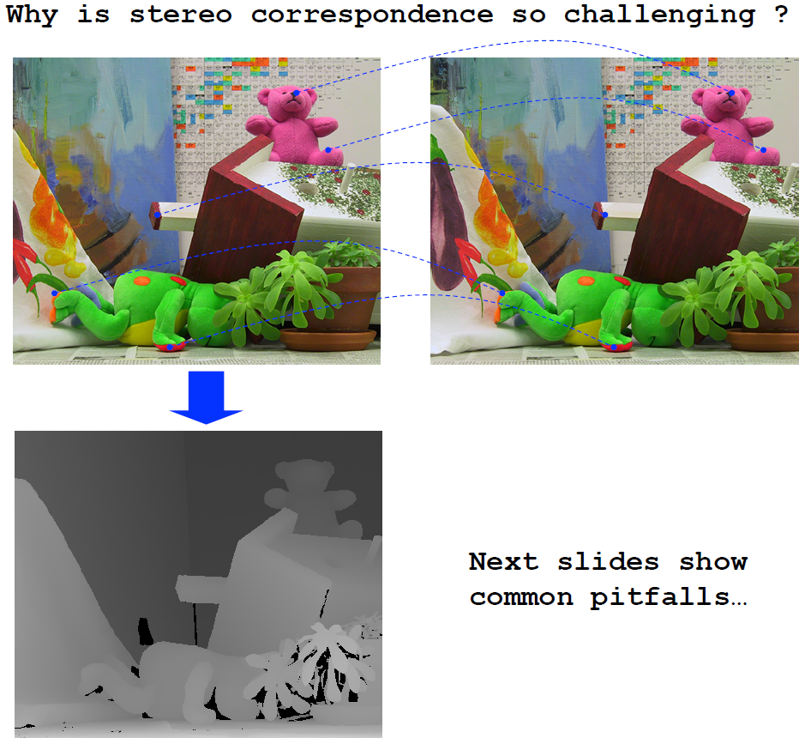

Slide 21
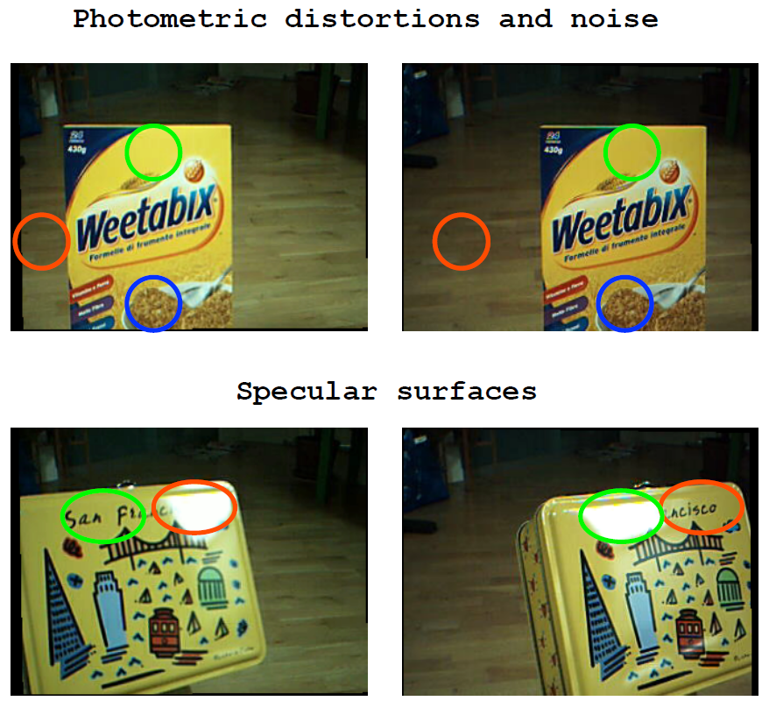

Slide 22
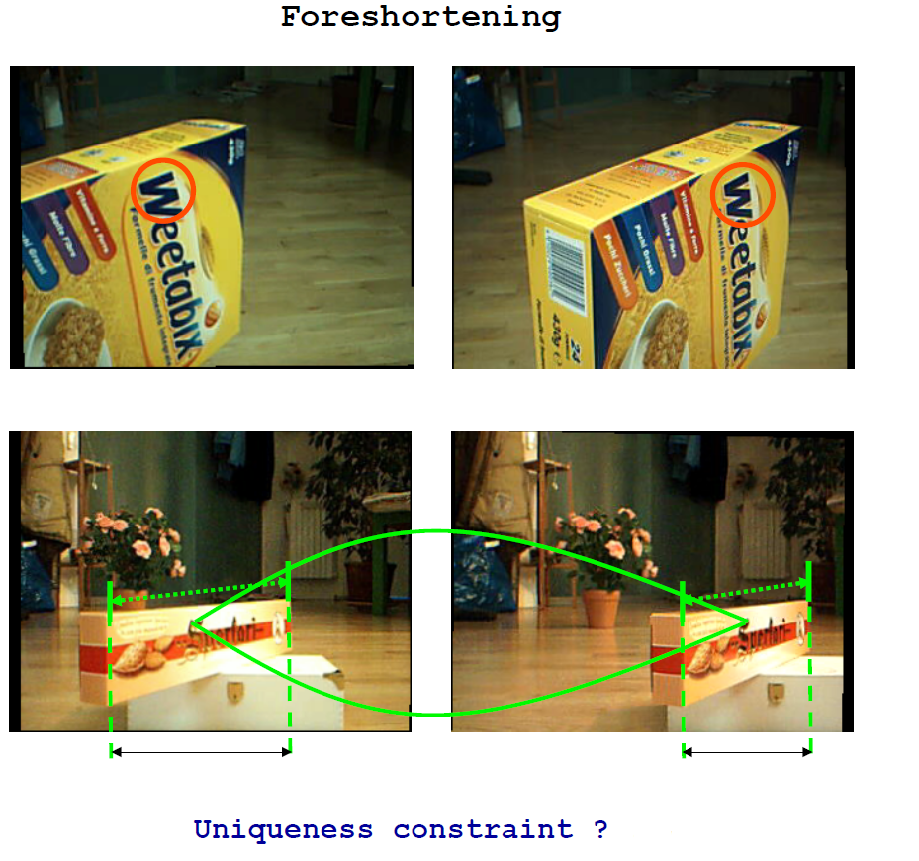

Slide 23
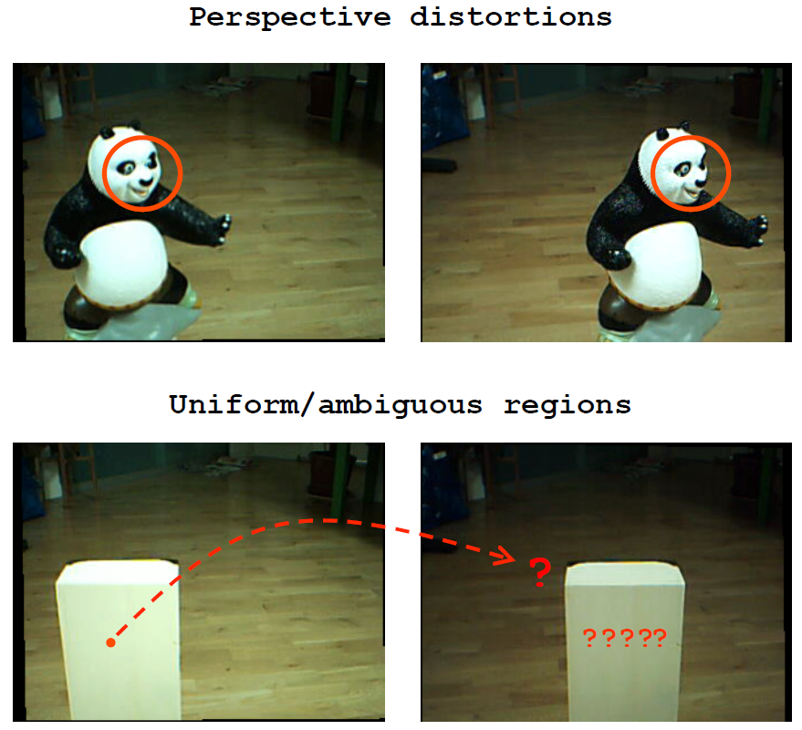

Slide 24
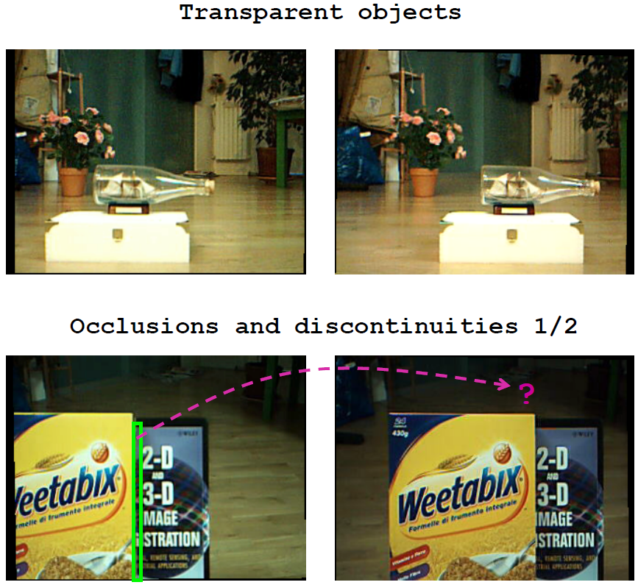

Slide 25
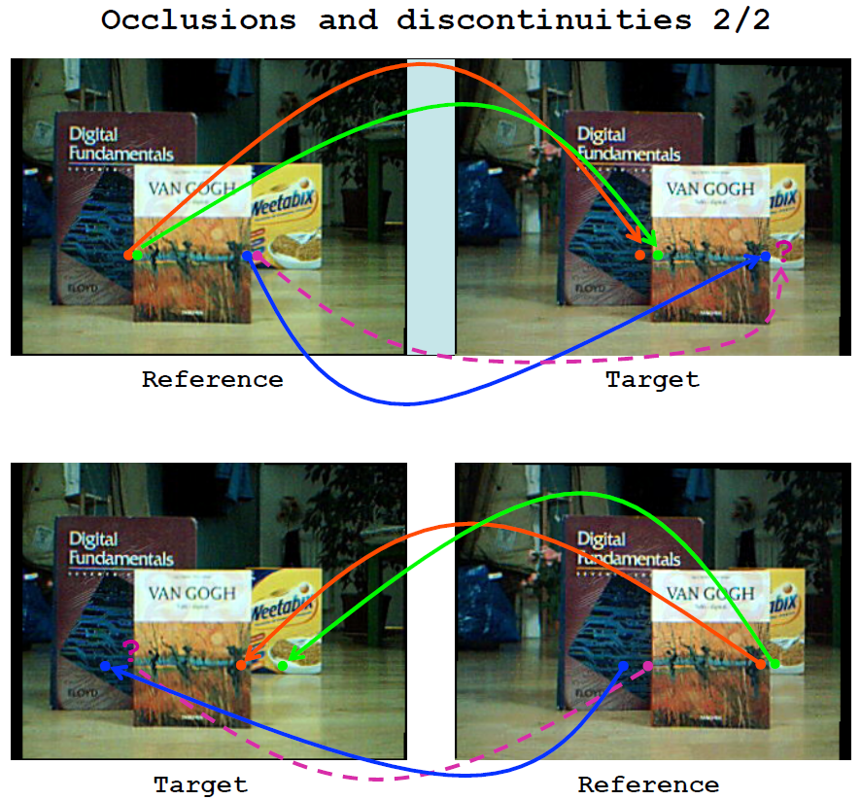

Slide 26
The Stereo matching problem
According to the taxonomy proposed in [1] most stereo algorithms
(subset of) these steps:
Matching cost computation
Cost aggregation
Disparity computation/optimization
Disparity refinement
Local algorithms perform:
1 => 2 =>3 (with a simple Winner Takes All (WTA) strategy)
Global Algorithms perform:
1 (=>2) =>3 (with global or semi-global reasoning)

Slide 27
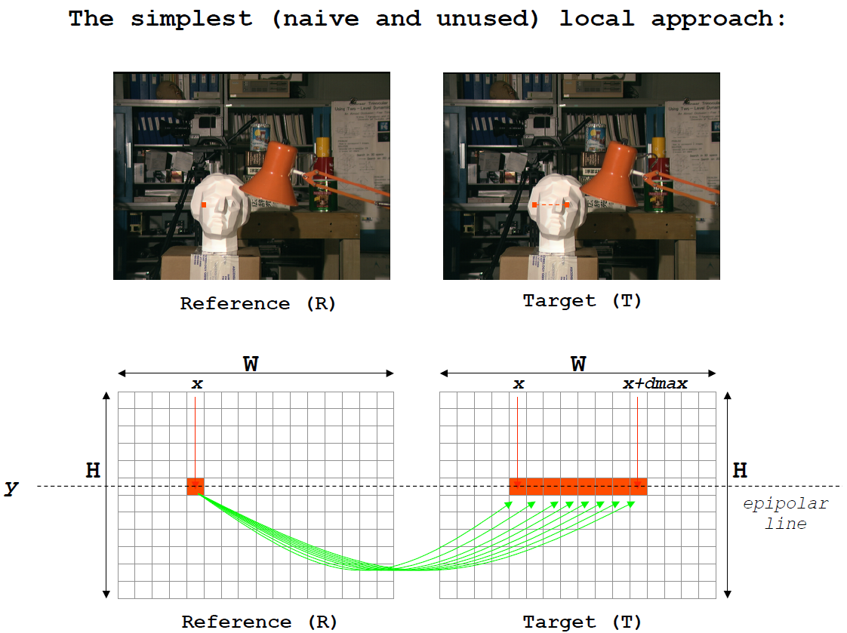

Slide 28
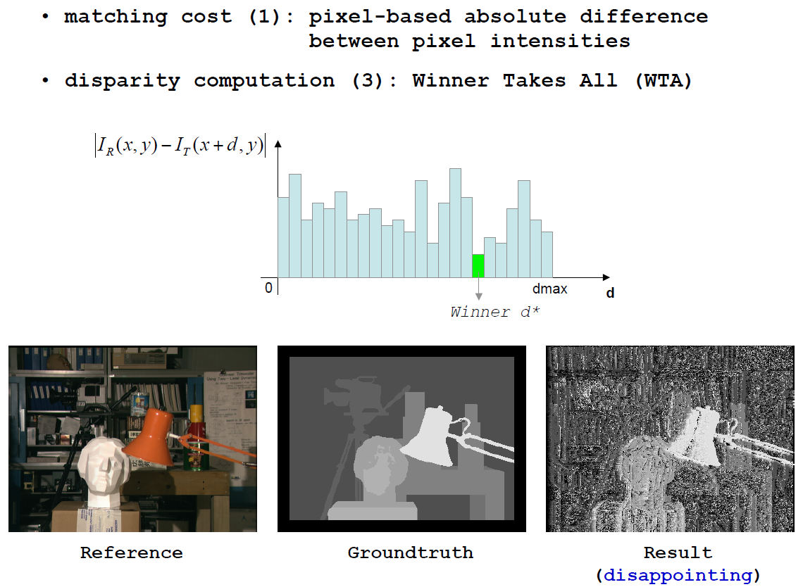

Slide 34
References
[1] D. Scharstein and R. Szeliski, A taxonomy and evaluation of dense two-frame stereo correspondence algorithms Int. Jour. Computer Vision, 47(1/2/3):7–42, 2002

